Slide 1

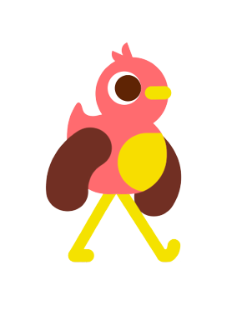
REFRESHMENT GAME
GROUP 3

Slide 2








GAME STORY
SELLER
NONG PHLOEUT

Slide 3

GAME OBJECTIVE
Chickens need to eat fruit.
it needs to eat bananas to get energy
If it eats fast food it will lose energy.
SELLER
NONG PHLOEUT

Slide 4
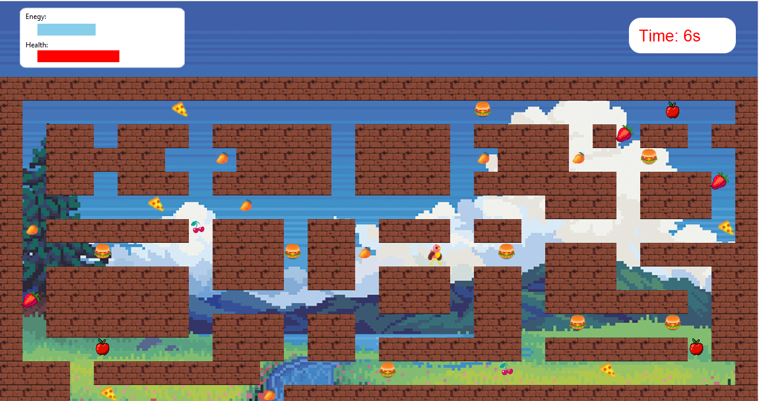
GAME PLAY
Energy
Use key move up down left right
SELLER
NONG PHLOEUT

Slide 5
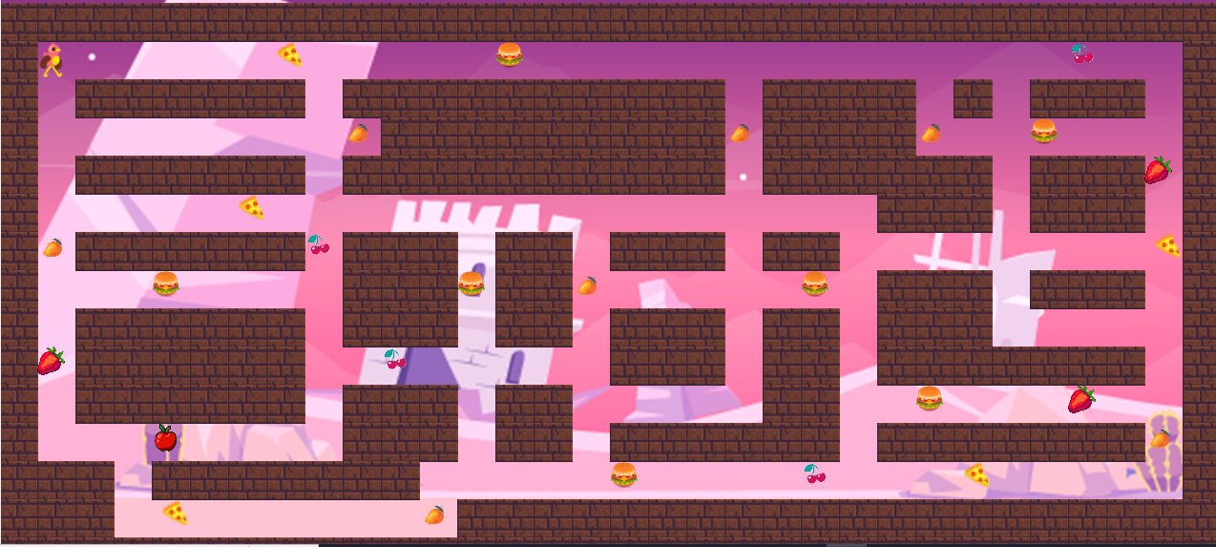
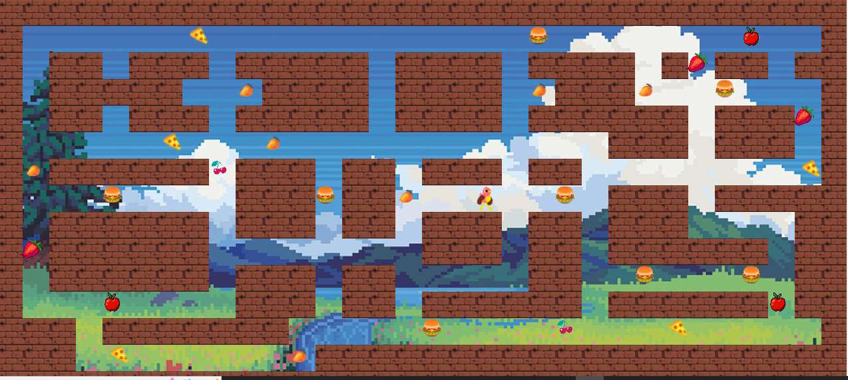
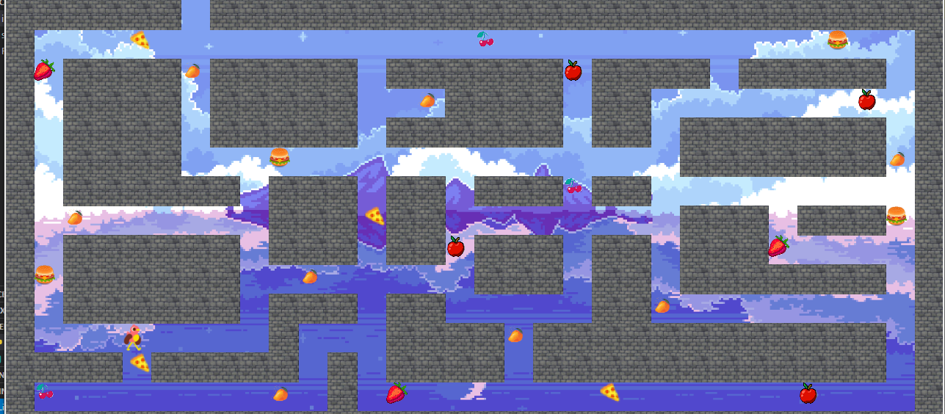
GAME PROGRESSION
LEVEL 1
LEVEL 2
LEVEL 3
SELLER
NONG PHLOEUT

Slide 6
WHAT DO WE LEARN ?
know about healthy food and unhealthy food
Improved cognitive abilities.
SELLER
NONG PHLOEUT

Slide 7
GAME DEMO
SELLER
NONG PHLOEUT

Slide 8

DATA STRUCTURE
TECH

Slide 9
FEATURE 1
TECH

Slide 10
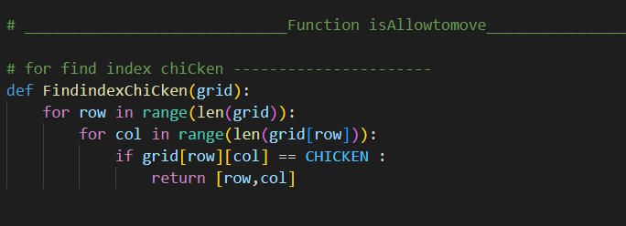
FEATURE 2
TECH

Slide 11





T H A N K Y O U

